Slide 1

Python Advanced
Course Introduction
SoftUni Team
Technical Trainers
Software University
https://softuni.bg/

Slide 2
Table of Contents
Course Objectives
Training Team
Course Organization
Course Schedule
Evaluation Criteria
Main Links
2

Slide 3
Have a Question?
sli.do
#python-advanced

Slide 4














SoftUni Diamond Partners

Slide 5

Educational Partners

Slide 6

Course Objectives

Slide 7
Python Advanced Objectives
Working with Lists as Stacks and Queues
Working with Tuples and Sets
Creating and working with Multidimensional Lists
Learning functional programming
Working with Files
Handling Exceptions
7

Slide 8

Training Team

Slide 9
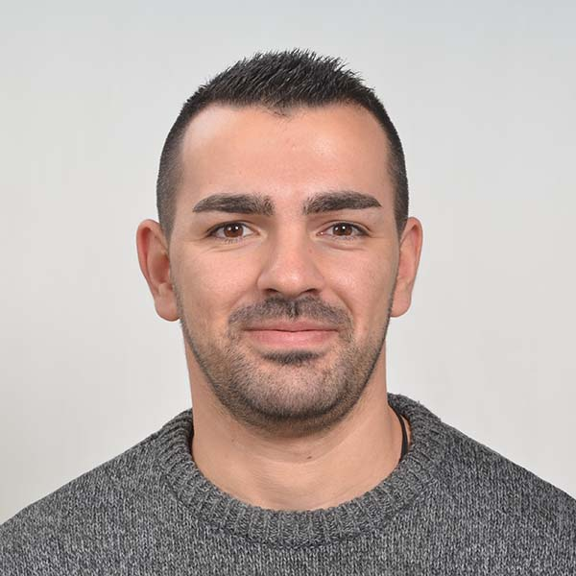
Mario Zahariev
Top student at SoftUni
Master of Cyber Security
4+ years of experience on Python
Interested in JavaScript, Artificial Intelligence and Go
Involved in researches related to artificial intelligence and machine learning

Slide 10

Diyan Kalaydzhiev
Full-Stack Python/JS Developer
Fluent in Python, Django, JS, HTML/CSS, React.js, Postgres
Student at NBU with Computer Science
Interested in the AI development

Slide 11

Course Organization

Slide 12
Python Advanced Course
10-Jan-2023
18-Feb-2023
12-Apr-2023
Python Advanced
5 weeks * 4 times / week
12 credits
Start: 10-Jan-2023
Practical Exam: 18-Feb-2023
Theoretical Exam: 18-Feb-2023
Retake Exams
Practical Retake Exam: 12-Apr-2023
Theoretical Retake Exam: 12-Apr-2023

Slide 13
Practical Programming Exam
Exam - 4 hours
3 practical problems
Stacks and Queues
Multidimensional Lists
Functions
13

Slide 14
Theoretical Exam
You will have 30 minutes once you enter
Multiple-choice with 1 correct answer
Test will be in English
Automated quiz system
Available on the day of the practical exam
You can submit your answers just one time
14

Slide 15


SoftUni Certificate
Practical Exam 100%
Homework 5%
Evaluation
15

Slide 16
CPE Certificate
Practical Exam
Theoretical Exam
Evaluation
16

Slide 17

Homework Assignments & Exercises
Your homework is mainly work in class
Lesson days → slides + live demos + exercises
Exercise days → only exercises
How to submit your homework?
Submitted in the judge system
Do your homework when it's due
Assignments pile up quickly

Slide 18


Learn to Search in Internet
The course assignments require to search in Internet
This is an important part of the learning process
Some exercises intentionally have no hints
Learn to find solutions!
Software development includes everyday searching and learning
No excuses, just learn to study!
Developers learn new technologies, tools, languages every day!

Slide 19



Course, Forum and FB Group
Official website:
Official discussion forum:
Official Facebook group:
Python Community Facebook group:
https://softuni.bg/trainings/3963/python-advanced-january-2023
https://softuni.bg/forum/categories/792/python-advanced
https://www.facebook.com/groups/PythonAdvancedJanuary2023
https://www.facebook.com/groups/SoftUniPythonCommunity

Slide 20
Questions?
Notes:
20

Slide 21
Trainings @ Software University (SoftUni)
Software University – High-Quality Education, Profession and Job for Software Developers
softuni.bg, softuni.org
Software University Foundation
softuni.foundation
Software University @ Facebook
facebook.com/SoftwareUniversity
Software University Forums
forum.softuni.bg
21
Notes:
21

Slide 22

License
This course (slides, examples, demos, exercises, homework, documents, videos, and other assets) is copyrighted content
Unauthorized copy, reproduction or use is illegal
© SoftUni – https://about.softuni.bg
© Software University – https://softuni.bg
Notes:
22

